Slide 1
Project Phase 3- Prediction
Team Blue - Sejal Arora

Slide 2
Goal
The goal of this phase is to predict the attrition flag attribute in the unlabeled dataset, which will help identify which customers are at risk of leaving.
The team used their unique models from Phase 2 to score the new records, which helped identify any potential attrition customers in the pre-production pilot test file.

Slide 3


Slide 4
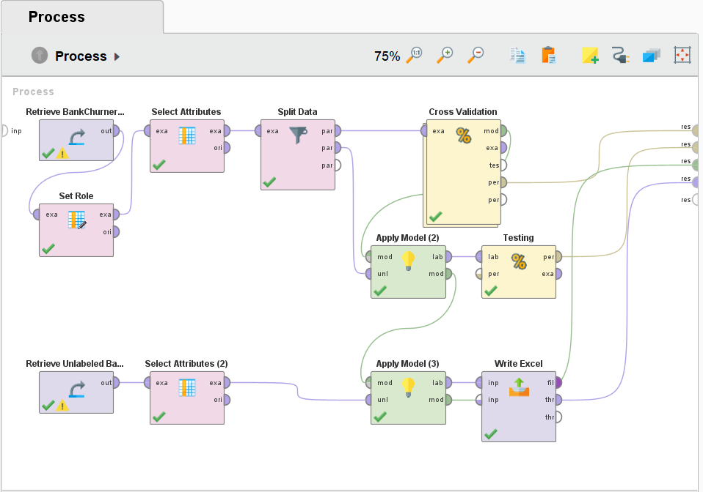
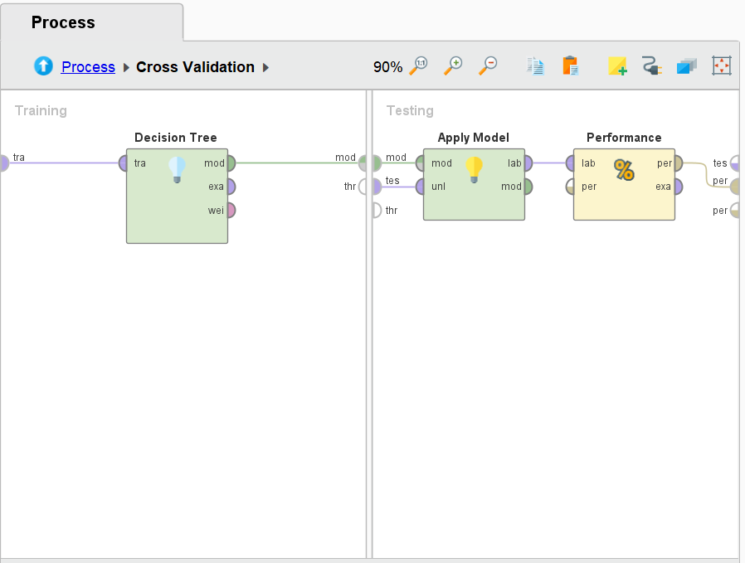
Process Design
This process is designed using the attributes selected during the Phase 2.
The data is split in the ratio of 80:20
The number of folds used for cross validation is 10.
The criterion used for Decision Tree is gain ratio.
Sejal Arora

Slide 5
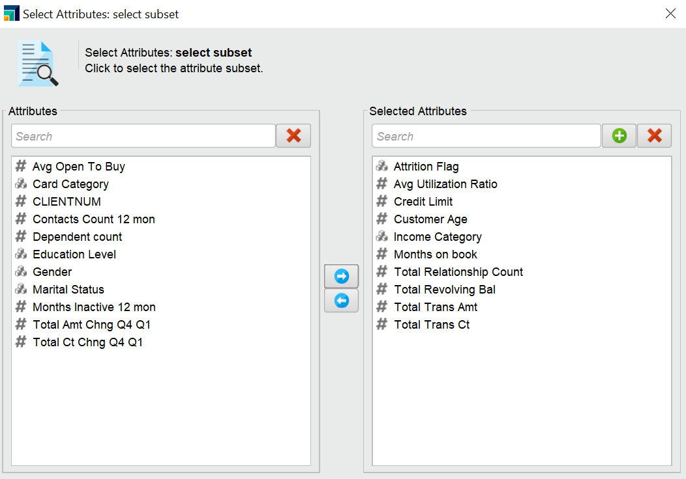
Selected Attributes
▪Avg Utilization Ratio
▪Credit limit
▪Customer Age
▪Income category
▪Months on book
▪Total Relationship Count
▪Total Revolving Bal
▪Total Transaction Amt
▪Total Transaction Count
▪Attrition Flag
Sejal Arora

Slide 6
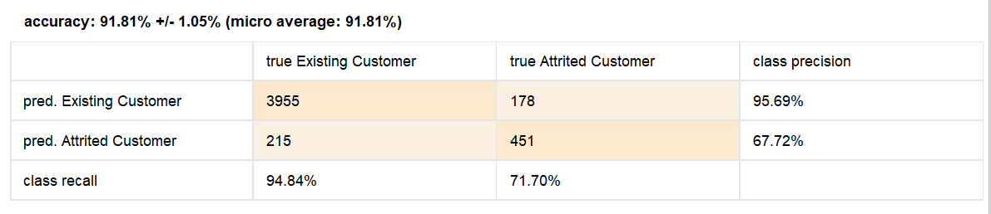
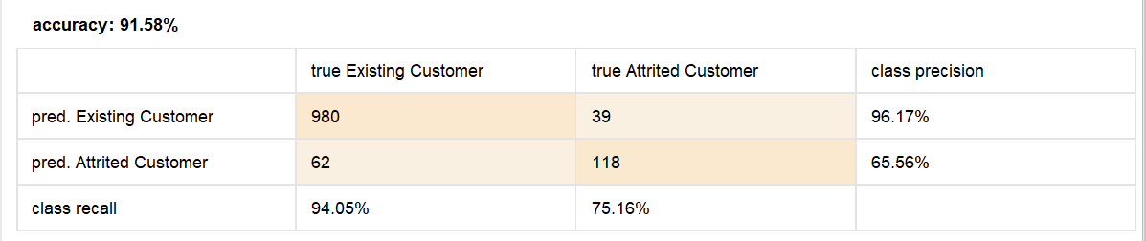
Results
Validation: Accuracy: 91.81%, Weighted mean Precision: 82.29%, Weighted mean Recall: 83.28%
Testing: Accuracy: 91.58%, Weighted mean Precision: 80.86%, Weighted mean Recall: 84.6%
Sejal Arora

Slide 7
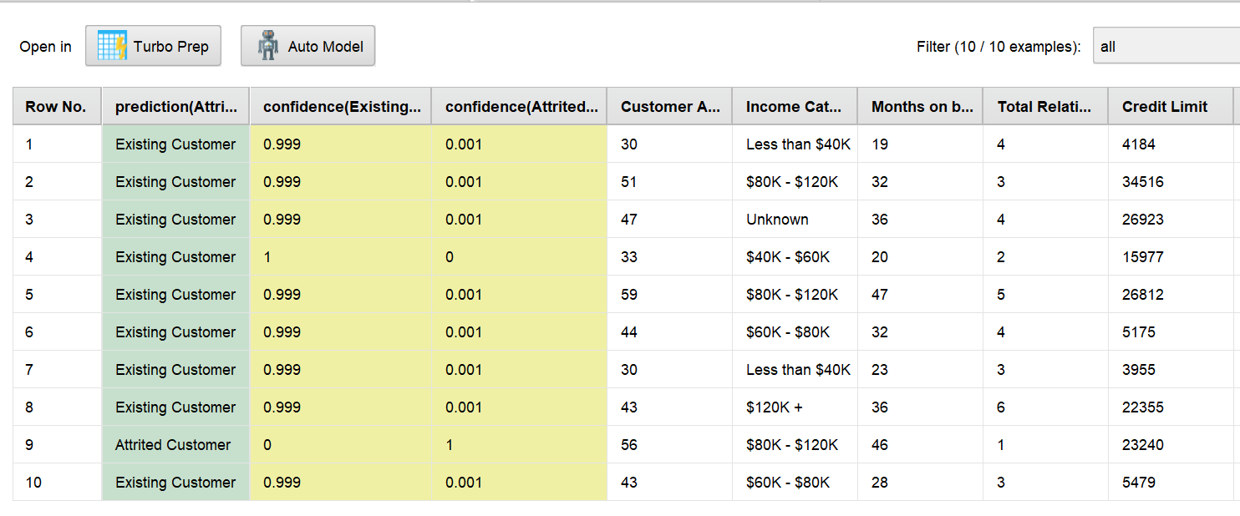
Prediction
Based on the results, we get one Attrited customer and nine Existing customers as the output using the attributes selected in phase 2.
Sejal Arora

Slide 8
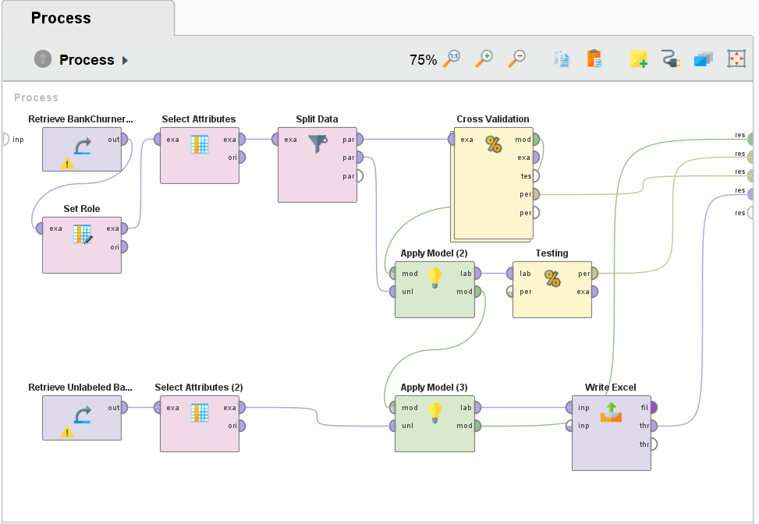
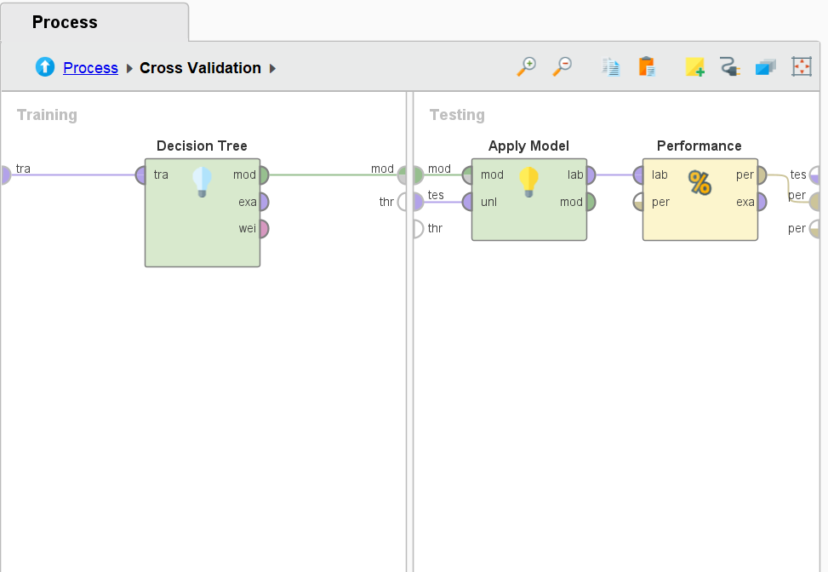
Process Design for Phase 3
This process is designed using the revised attributes selected for Phase 3.
The data is split in the ratio of 80:20
The number of folds used for cross validation is 10.
The criterion used for Decision Tree is gain ratio.
Sejal Arora

Slide 9
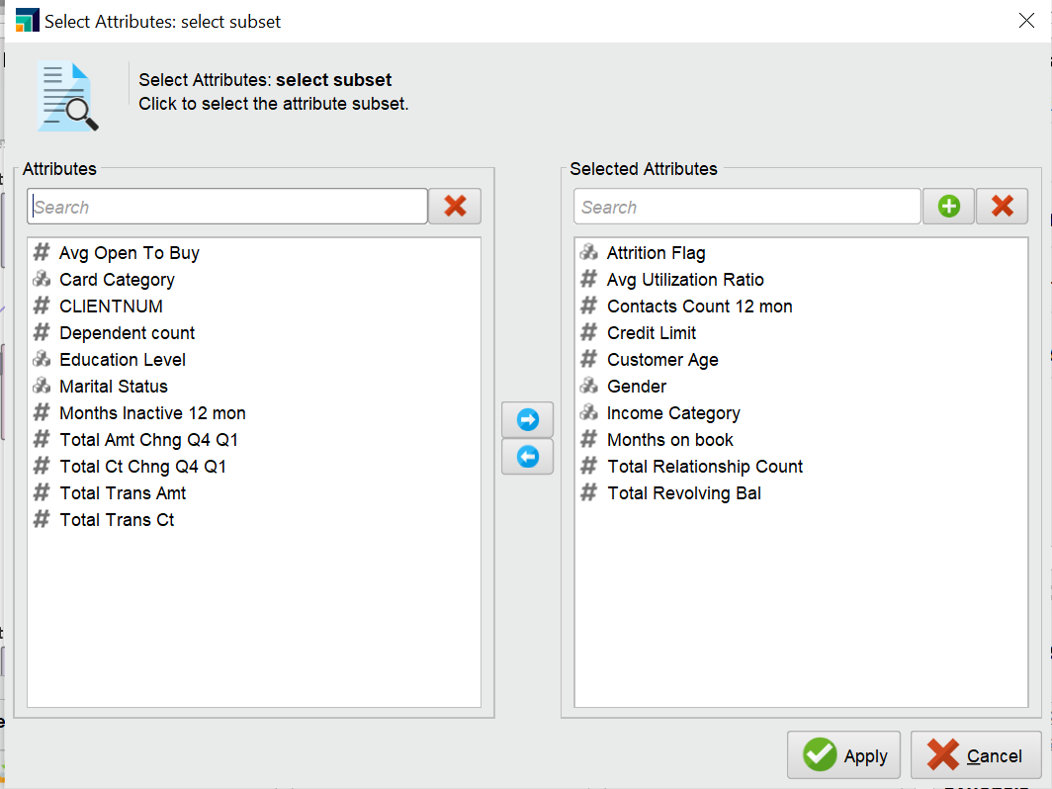
Selected Attributes
Avg Utilization Ratio
Contacts Count 12 mon
Credit Limit
Customer Age
Gender
Income Category
Months on Book
Total Relationship Count
Total Revolving Balance
Attrition Flag
Sejal Arora

Slide 10
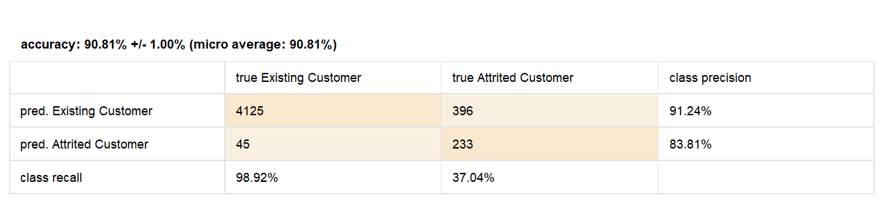
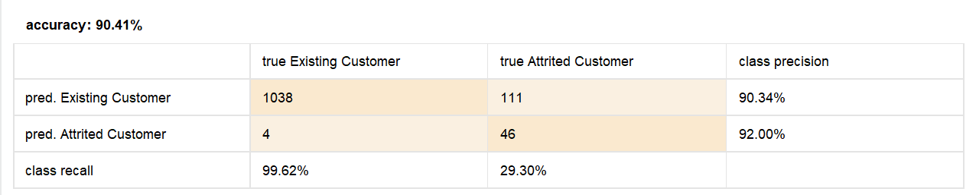
Results
Validation: Accuracy: 90.81%, Weighted mean Precision: 87.83%, Weighted mean Recall: 67.98%
Testing: Accuracy: 90.41%, Weighted mean Precision: 91.17%, Weighted mean Recall: 64.46%
Sejal Arora

Slide 11
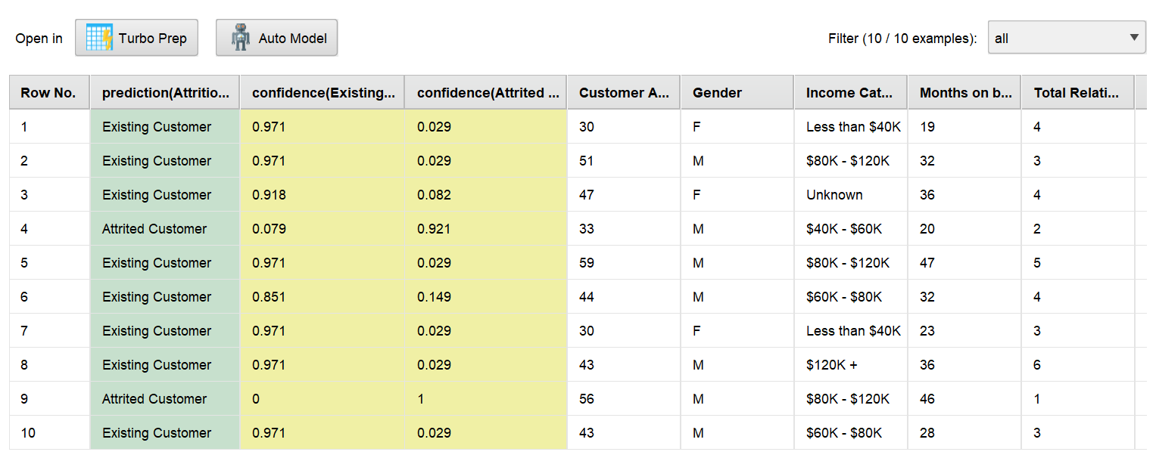
Prediction
Based on the results, we get two Attrited customers and eight Existing customers as the output using the attributes selected for phase 3.
Sejal Arora

Slide 12
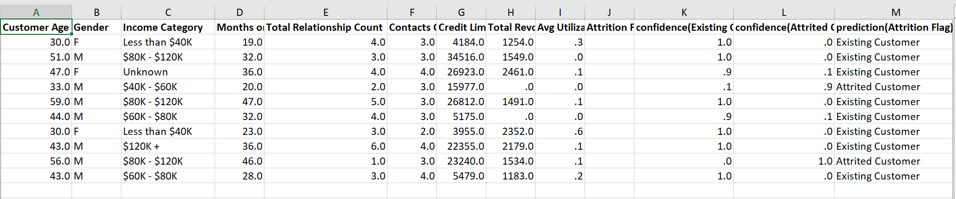
Prediction Result in the Excel Sheet
Sejal Arora

Slide 13
Advice for the Bank
Customers with a higher number of relationships with the bank may be less likely to churn. So the bank could offer incentives or rewards programs to the customers with less total relationship count and encourage them to open additional accounts to reduce their churn rate.
Customers who have had fewer interactions with the bank in the past year may be at a higher risk of churn. The bank could reach out to these customers with personalized offers or promotions to encourage them to not leave the bank services.
▪Banks can identify customers who have been with the bank for a longer time. Such customers can be offered exclusive deals and rewards to incentivize them to stay.

Slide 14
THANK YOU!

